Slide 1
Matrix chart/Correlogram

Slide 2
Definition
A matrix chart shows relationships between two or more variables in a data set in grid format.
The matrix diagram shows the relationship between two, three, or four groups of information.
It also can give information about the relationship, such as its strength.
They help us to expose interactions and dependencies between things that help us to understand complex causal relationships.
Six differently shaped matrices are possible: L, T, Y, X, C, and roof-shaped, depending on how many groups must be compared.

Slide 3
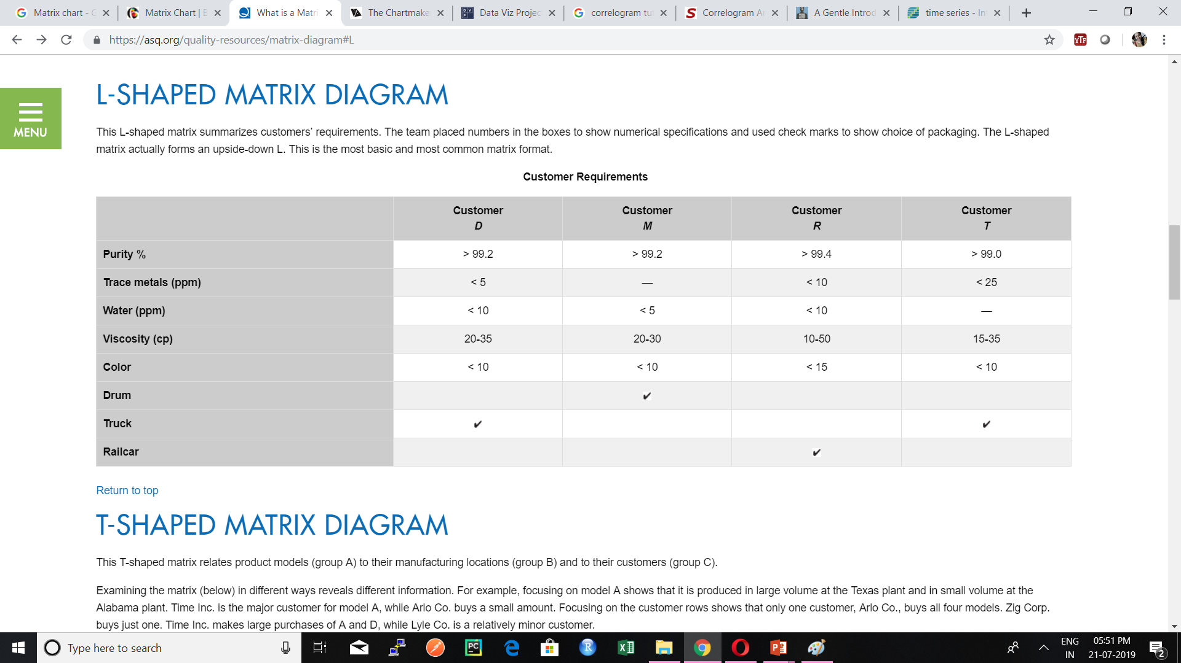
L-shaped matrix chart

Slide 4
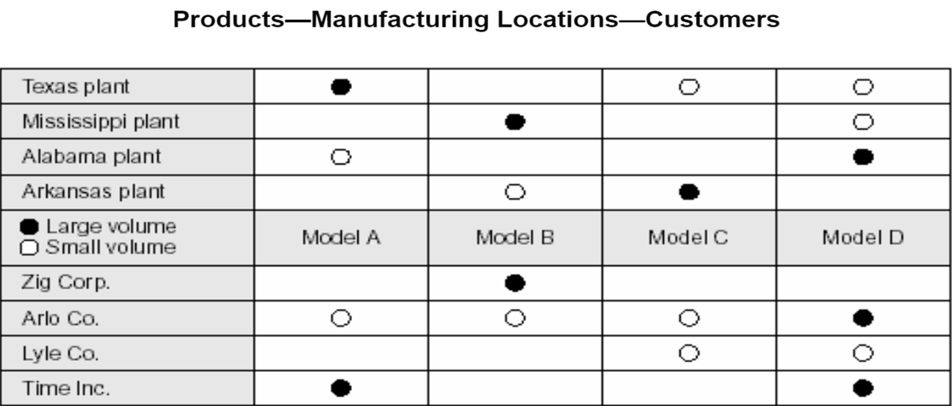
T-shaped matrix chart

Slide 5
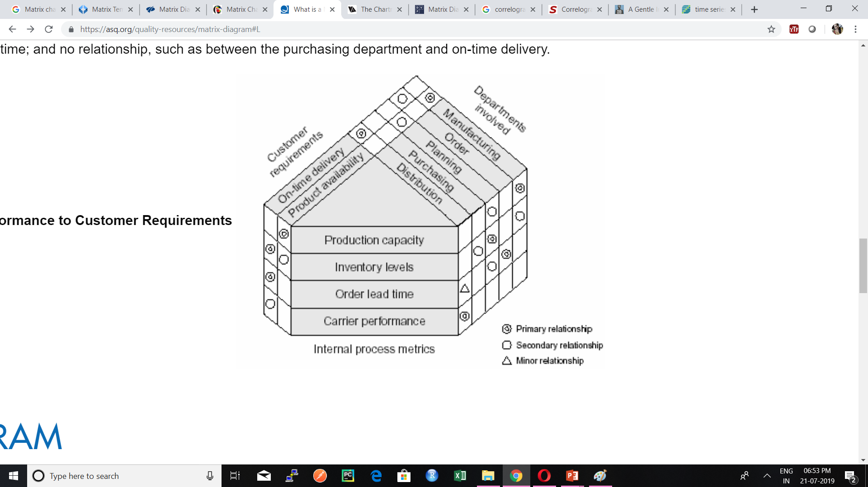
Y-shaped matrix chart

Slide 6
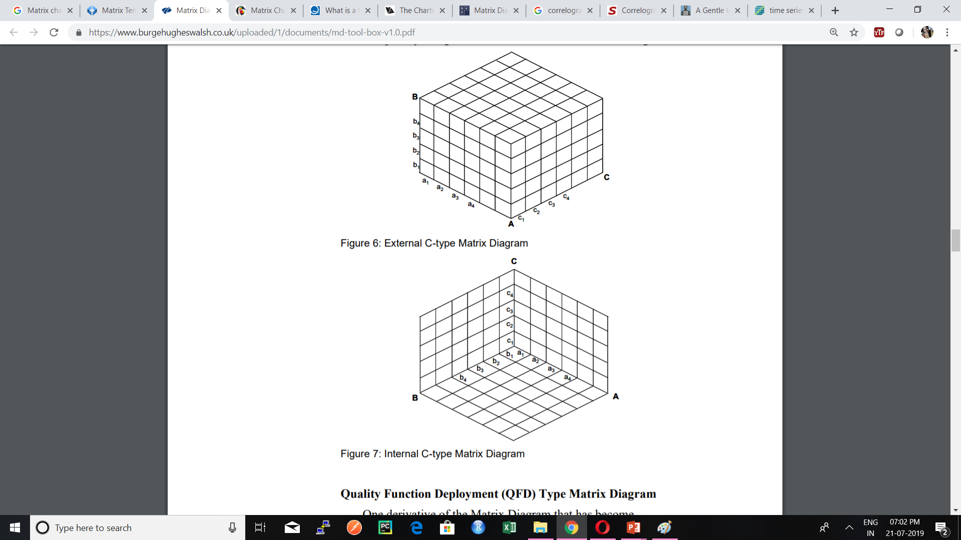
C-shaped matrix chart

Slide 7
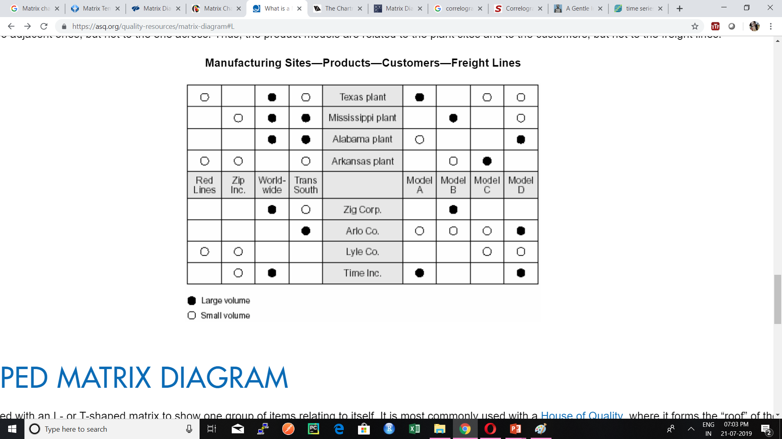
X-shaped matrix chart

Slide 8
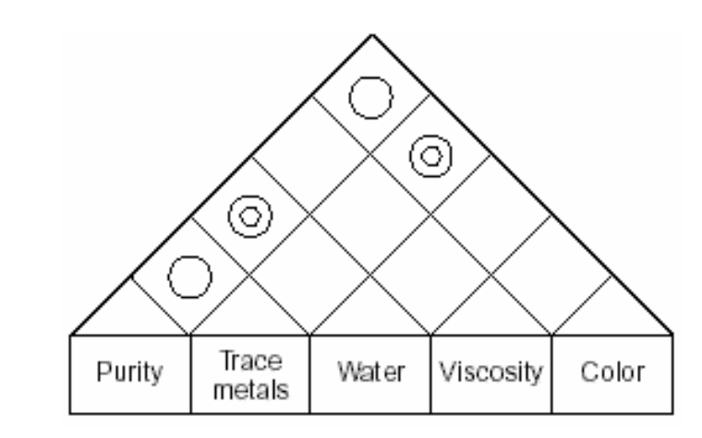
Roof-shaped matrix chart

Slide 9
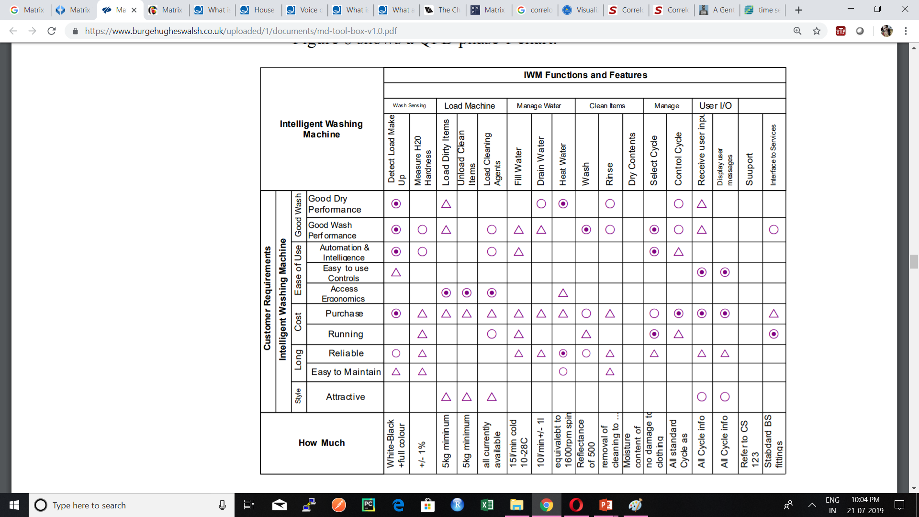
Quality Function Deployment

Slide 10
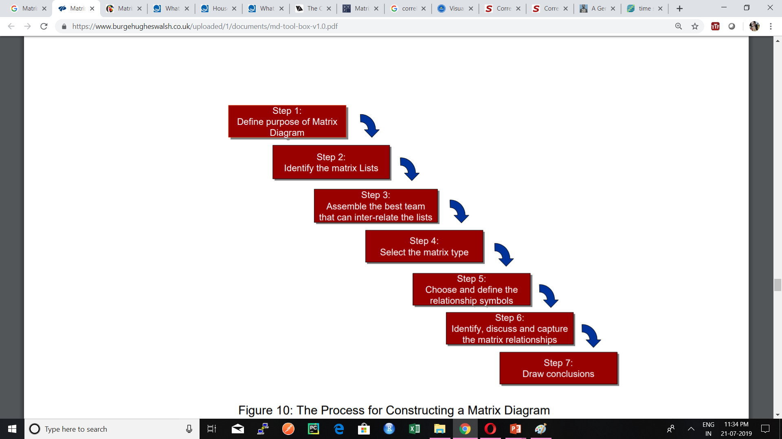
Construction of Matrix diagram

Slide 11
Correlogram
Correlogram is a graph of correlation matrix.
It is very useful to highlight the most correlated variables in a data table.
In this plot, correlation coefficients are coloured according to the value.

Slide 12
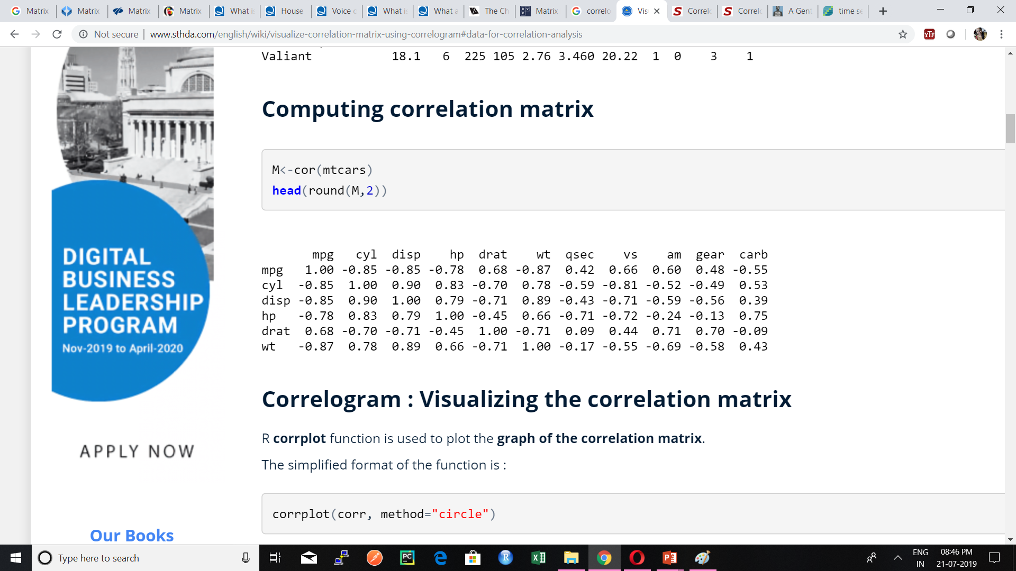
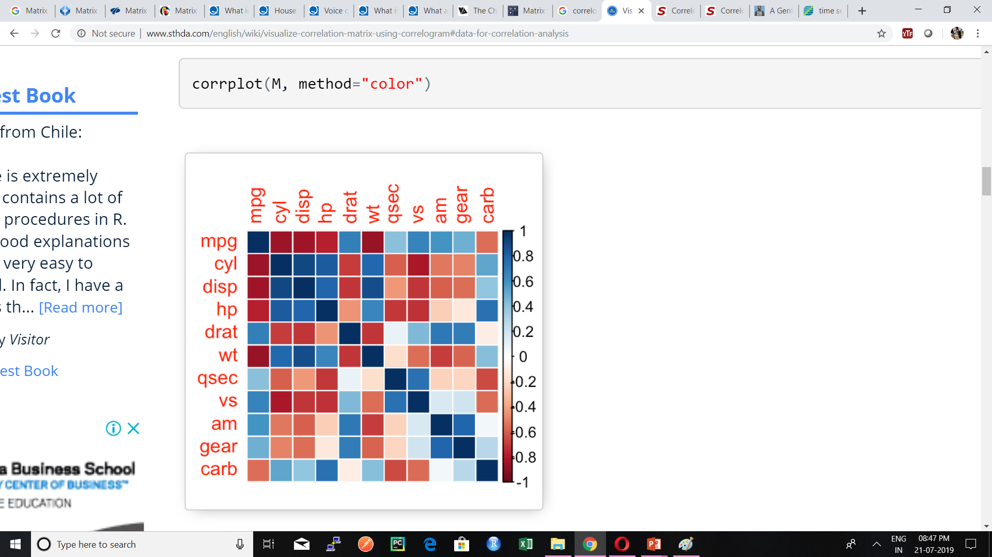
Example

Slide 13
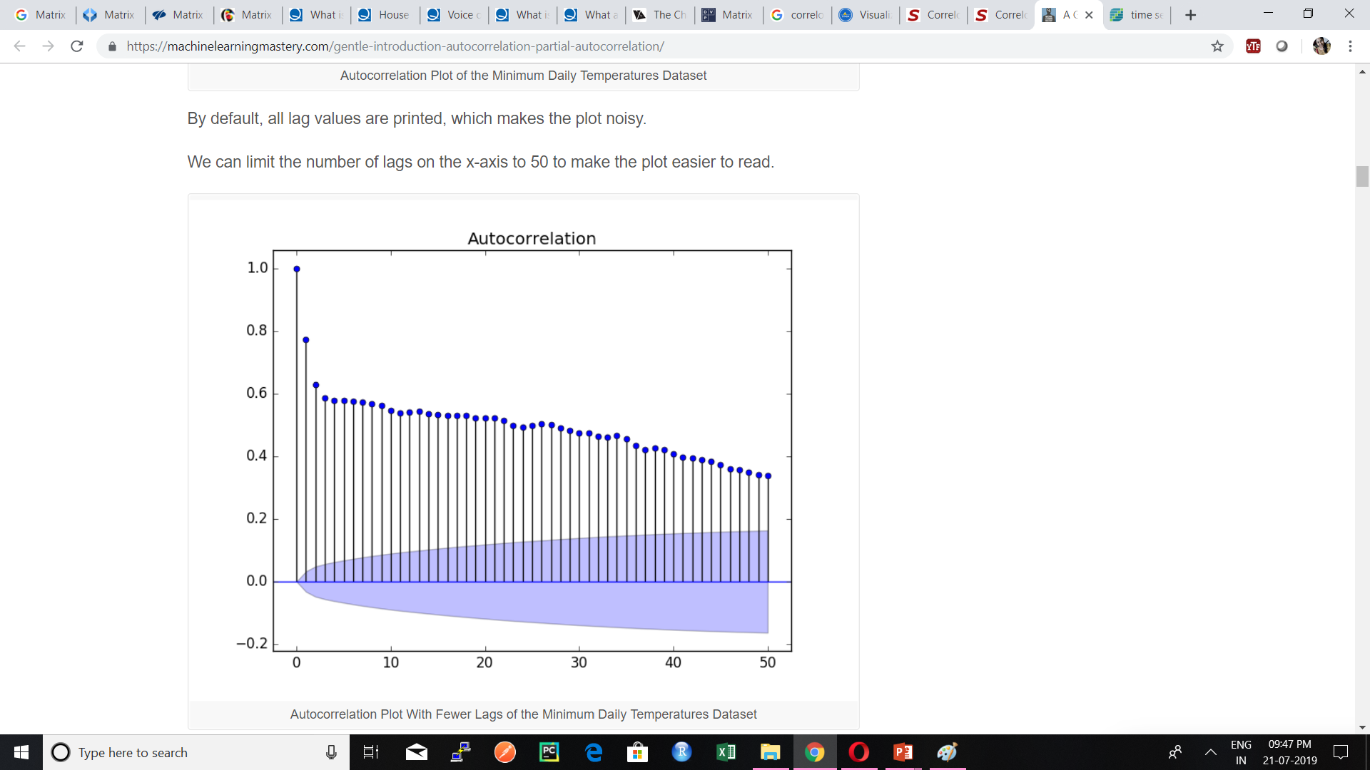
Auto Correlation plot

Slide 14
References
https://asq.org/quality-resources/matrix-diagram
https://www.burgehugheswalsh.co.uk/uploaded/1/documents/md-tool-box-v1.0.pdf
https://www.betterevaluation.org/en/evaluation-options/matrixchart
http://www.sthda.com/english/wiki/visualize-correlation-matrix-using-correlogram#data-for-correlation-analysis

Slide 15
THANK YOU

